Slide 1
Python crawler

Slide 2
原始碼抓取
# 抓取 PTT 電影版的網頁元原始碼 (HTML)
import urllib.request as req
url="https://www.ptt.cc/bbs/movie/index.html"
# 建立一個Request 物件，附加 Request Headers 的資訊
request=req.Request(url, headers={
"User-Agent" : "Mozilla/5.0 (Windows NT 10.0; Win64; x64) AppleWebKit/537.36 (KHTML, like Gecko) Chrome/87.0.4280.66 Safari/537.36"
})
with req.urlopen(request) as response:
data=response.read().decode("utf-8")
print(data)
# 解析原始碼

Slide 3
原始碼抓取-結果
<!DOCTYPE html>
<html>
<head>
<meta charset="utf-8">
<meta name="viewport" content="width=device-width, initial-scale=1">
<title>看板 movie 文章列表 - 批踢踢實業坊</title>
<link rel="stylesheet" type="text/css" href="//images.ptt.cc/bbs/v2.27/bbs-common.css">
<link rel="stylesheet" type="text/css" href="//images.ptt.cc/bbs/v2.27/bbs-base.css" media="screen">
<link rel="stylesheet" type="text/css" href="//images.ptt.cc/bbs/v2.27/bbs-custom.css">
<link rel="stylesheet" type="text/css" href="//images.ptt.cc/bbs/v2.27/pushstream.css" media="screen">
<link rel="stylesheet" type="text/css" href="//images.ptt.cc/bbs/v2.27/bbs-print.css" media="print">
</head>
<body>
<div id="topbar-container">
<div id="topbar" class="bbs-content">
<a id="logo" href="/bbs/">批踢踢實業坊</a>
<span>&rsaquo;</span>
<a class="board" href="/bbs/movie/index.html"><span class="board-label">看板 </span>movie</a>
<a class="right small" href="/about.html">關於我們</a>
<a class="right small" href="/contact.html">聯絡資訊</a>
</div>
</div>
<div id="main-container">
<div id="action-bar-container">
<div class="action-bar">
<div class="btn-group btn-group-dir">
<a class="btn selected" href="/bbs/movie/index.html">看板</a>
<a class="btn" href="/man/movie/index.html">精華區</a>
</div>
<div class="btn-group btn-group-paging">
<a class="btn wide" href="/bbs/movie/index1.html">最舊</a>
<a class="btn wide" href="/bbs/movie/index9380.html">&lsaquo; 上頁</a>
<a class="btn wide disabled">下頁 &rsaquo;</a>
<a class="btn wide" href="/bbs/movie/index.html">最新</a>
</div>
</div>
</div>
<div class="r-list-container action-bar-margin bbs-screen">
<div class="search-bar">
<form type="get" action="search" id="search-bar">
<input class="query" type="text" name="q" value="" placeholder="搜尋文章&#x22ef;">
</form>
</div>
<div class="r-ent">
<div class="nrec"><span class="hl f3">24</span></div>
<div class="title">
<a href="/bbs/movie/M.1606019851.A.422.html">[討論] 孤味票房爆了</a>
</div>
<div class="meta">
<div class="author">yslimit</div>
<div class="article-menu">
<div class="trigger">&#x22ef;</div>
<div class="dropdown">
<div class="item"><a href="/bbs/movie/search?q=thread%3A%5B%E8%A8%8E%E8%AB%96%5D&#43;%E5%AD%A4%E5%91%B3%E7%A5%A8%E6%88%BF%E7%88%86%E4%BA%86">搜尋同標題文章</a></div>
<div class="item"><a href="/bbs/movie/search?q=author%3Ayslimit">搜尋看板內 yslimit 的文章</a></div>
</div>
</div>
<div class="date">11/22</div>
<div class="mark"></div>
</div>
</div>
<div class="r-ent">
<div class="nrec"><span class="hl f2">1</span></div>
<div class="title">
<a href="/bbs/movie/M.1606021094.A.C42.html">[新聞] 查寧坦圖入主環球怪物宇宙！將與《龍虎少</a>
</div>
<div class="meta">
<div class="author">CYKONGG</div>
<div class="article-menu">
<div class="trigger">&#x22ef;</div>
<div class="dropdown">
<div class="item"><a href="/bbs/movie/search?q=thread%3A%5B%E6%96%B0%E8%81%9E%5D&#43;%E6%9F%A5%E5%AF%A7%E5%9D%A6%E5%9C%96%E5%85%A5%E4%B8%BB%E7%92%B0%E7%90%83%E6%80%AA%E7%89%A9%E5%AE%87%E5%AE%99%EF%BC%81%E5%B0%87%E8%88%87%E3%80%8A%E9%BE%8D%E8%99%8E%E5%B0%91">搜尋同標題文章</a></div>
<div class="item"><a href="/bbs/movie/search?q=author%3ACYKONGG">搜尋看板內 CYKONGG 的文章</a></div>
</div>
</div>
<div class="date">11/22</div>
<div class="mark"></div>
</div>
</div>
<div class="r-ent">
<div class="nrec"><span class="hl f2">1</span></div>
<div class="title">
<a href="/bbs/movie/M.1606022346.A.1DE.html">[ 極好雷] 同學麥娜絲今年最佳國片</a>
</div>
<div class="meta">
<div class="author">rs6677</div>
<div class="article-menu">
<div class="trigger">&#x22ef;</div>
<div class="dropdown">
<div class="item"><a href="/bbs/movie/search?q=thread%3A%5B&#43;%E6%A5%B5%E5%A5%BD%E9%9B%B7%5D&#43;%E5%90%8C%E5%AD%B8%E9%BA%A5%E5%A8%9C%E7%B5%B2%E4%BB%8A%E5%B9%B4%E6%9C%80%E4%BD%B3%E5%9C%8B%E7%89%87">搜尋同標題文章</a></div>
<div class="item"><a href="/bbs/movie/search?q=author%3Ars6677">搜尋看板內 rs6677 的文章</a></div>
</div>
</div>
<div class="date">11/22</div>
<div class="mark"></div>
</div>
</div>
<div class="r-ent">
<div class="nrec"><span class="hl f2">3</span></div>
<div class="title">
<a href="/bbs/movie/M.1606022481.A.053.html">[請益] 已上映的片子金馬送審時是否可能不同版本</a>
</div>
<div class="meta">
<div class="author">n6335097</div>
<div class="article-menu">
<div class="trigger">&#x22ef;</div>
<div class="dropdown">
<div class="item"><a href="/bbs/movie/search?q=thread%3A%5B%E8%AB%8B%E7%9B%8A%5D&#43;%E5%B7%B2%E4%B8%8A%E6%98%A0%E7%9A%84%E7%89%87%E5%AD%90%E9%87%91%E9%A6%AC%E9%80%81%E5%AF%A9%E6%99%82%E6%98%AF%E5%90%A6%E5%8F%AF%E8%83%BD%E4%B8%8D%E5%90%8C%E7%89%88%E6%9C%AC">搜尋同標題文章</a></div>
<div class="item"><a href="/bbs/movie/search?q=author%3An6335097">搜尋看板內 n6335097 的文章
</a></div>
</div>
</div>
<div class="date">11/22</div>
<div class="mark"></div>
</div>
</div>
<div class="r-list-sep"></div>
<div class="r-ent">
<div class="nrec"><span class="hl f3">33</span></div>
<div class="title">
<a href="/bbs/movie/M.1559611458.A.DCA.html">[公告] 板規 2020/03/01 (增加14.1)</a>
</div>
<div class="meta">
<div class="author">ckshchen</div>
<div class="article-menu">
<div class="trigger">&#x22ef;</div>
<div class="dropdown">
<div class="item"><a href="/bbs/movie/search?q=thread%3A%5B%E5%85%AC%E5%91%8A%5D&#43;%E6%9D%BF%E8%A6%8F&#43;2020%2F03%2F01&#43;%28%E5%A2%9E%E5%8A%A014.1%29">搜尋同標題文章</a></div>
<div class="item"><a href="/bbs/movie/search?q=author%3Ackshchen">搜尋看板內 ckshchen 的文章
</a></div>
</div>
</div>
<div class="date"> 6/04</div>
<div class="mark">M</div>
</div>
</div>
<div class="r-ent">
<div class="nrec"><span class="hl f3">20</span></div>
<div class="title">
<a href="/bbs/movie/M.1578684521.A.1B8.html">[公告] 關於跑步哥</a>
</div>
<div class="meta">
<div class="author">ckshchen</div>
<div class="article-menu">
<div class="trigger">&#x22ef;</div>
<div class="dropdown">
<div class="item"><a href="/bbs/movie/search?q=thread%3A%5B%E5%85%AC%E5%91%8A%5D&#43;%E9%97%9C%E6%96%BC%E8%B7%91%E6%AD%A5%E5%93%A5">搜尋同標題文章</a></div>
<div class="item"><a href="/bbs/movie/search?q=author%3Ackshchen">搜尋看板內 ckshchen 的文章
</a></div>
</div>
</div>
<div class="date"> 1/11</div>
<div class="mark">M</div>
</div>
</div>
<div class="r-ent">
<div class="nrec"><span class="hl f1">爆</span></div>
<div class="title">
<a href="/bbs/movie/M.1589355894.A.CDD.html">[情報] 近期院線預計重映片單</a>
</div>
<div class="meta">
<div class="author">lgng66133</div>
<div class="article-menu">
<div class="trigger">&#x22ef;</div>
<div class="dropdown">
<div class="item"><a href="/bbs/movie/search?q=thread%3A%5B%E6%83%85%E5%A0%B1%5D&#43;%E8%BF%91%E6%9C%9F%E9%99%A2%E7%B7%9A%E9%A0%90%E8%A8%88%E9%87%8D%E6%98%A0%E7%89%87%E5%96%AE">搜尋同標題文章</a></div>
<div class="item"><a href="/bbs/movie/search?q=author%3Algng66133">搜尋看板內 lgng66133 的文
章</a></div>
</div>
</div>
<div class="date"> 5/13</div>
<div class="mark">M</div>
</div>
</div>
<div class="r-ent">
<div class="nrec"></div>
<div class="title">
<a href="/bbs/movie/M.1596465114.A.0D2.html">[公告][板規] 電影版申訴與檢舉辦法</a>
</div>
<div class="meta">
<div class="author">hhwang</div>
<div class="article-menu">
<div class="trigger">&#x22ef;</div>
<div class="dropdown">
<div class="item"><a href="/bbs/movie/search?q=thread%3A%5B%E5%85%AC%E5%91%8A%5D%5B%E6%9D%BF%E8%A6%8F%5D&#43;%E9%9B%BB%E5%BD%B1%E7%89%88%E7%94%B3%E8%A8%B4%E8%88%87%E6%AA%A2%E8%88%89%E8%BE%A6%E6%B3%95">搜尋同標題文章</a></div>
<div class="item"><a href="/bbs/movie/search?q=author%3Ahhwang">搜尋看板內 hhwang 的文章</a></div>
</div>
</div>
<div class="date"> 8/03</div>
<div class="mark">M</div>
</div>
</div>
<div class="r-ent">
<div class="nrec"><span class="hl f2">2</span></div>
<div class="title">
<a href="/bbs/movie/M.1597242609.A.606.html">[公告] 電影板板規12/08/2020</a>
</div>
<div class="meta">
<div class="author">TtTt4</div>
<div class="article-menu">
<div class="trigger">&#x22ef;</div>
<div class="dropdown">
<div class="item"><a href="/bbs/movie/search?q=thread%3A%5B%E5%85%AC%E5%91%8A%5D&#43;%E9%9B%BB%E5%BD%B1%E6%9D%BF%E6%9D%BF%E8%A6%8F12%2F08%2F2020">搜尋同標題文章</a></div>
<div class="item"><a href="/bbs/movie/search?q=author%3ATtTt4">搜尋看板內 TtTt4 的文章</a></div>
</div>
</div>
<div class="date"> 8/12</div>
<div class="mark">M</div>
</div>
</div>
</div>
</div>
<script>
(function(i,s,o,g,r,a,m){i['GoogleAnalyticsObject']=r;i[r]=i[r]||function(){
(i[r].q=i[r].q||[]).push(arguments)},i[r].l=1*new Date();a=s.createElement(o),
m=s.getElementsByTagName(o)[0];a.async=1;a.src=g;m.parentNode.insertBefore(a,m)
})(window,document,'script','https://www.google-analytics.com/analytics.js','ga');
ga('create', 'UA-32365737-1', {
cookieDomain: 'ptt.cc',
legacyCookieDomain: 'ptt.cc'
});
ga('send', 'pageview');
</script>
<script src="//ajax.googleapis.com/ajax/libs/jquery/2.1.1/jquery.min.js"></script>
<script src="//images.ptt.cc/bbs/v2.27/bbs.js"></script>
</body>
</html>

Slide 4
BeautifulSoup
BeautifulSoup 是一個用來解析HTML結構的Python套件(Package)，將取回的網頁HTML結構
Beautifulsoup套件(Package)可透過pip指令來進行安裝，如下範例：
pip install beautifulsoup4

Slide 5
BeautifulSoup 應用
import requests as rq
from bs4 import BeautifulSoup
url = “https://www.ptt.cc/bbs/NBA/index.html” # PTT NBA 板
response = rq.get(url) # 用 requests 的 get 方法把網頁抓下來
html_doc = response.text # text 屬性就是 html 檔案
soup = BeautifulSoup(response.text, “lxml”) # 指定 lxml 作為解析器
print(soup.prettify()) # 把排版後的 html 印出來

Slide 6
BeautifulSoup 的屬性或方法
• title 屬性
• title.name 屬性
• title.string 屬性
• title.parent.name 屬性
• a 屬性
• find_all() 方法

Slide 7
import requests as rq
from bs4 import BeautifulSoup
url = "https://www.ptt.cc/bbs/NBA/index.html"
response = rq.get(url)
html_doc = response.text soup = BeautifulSoup(response.text, "lxml")
print(soup.title) # 把 tag 抓出來
print("---")
print(soup.title.name) # 把 title 的 tag 名稱抓出來
print("---")
print(soup.title.string) # 把 title tag 的內容欻出來
print("---")
print(soup.title.parent.name) # title tag 的上一層 tag
print("---")
print(soup.a) # 把第一個 <a></a> 抓出來
print("---")
print(soup.find_all('a')) # 把所有的 <a></a> 抓出來

Slide 8
bs4 元素 (素子そし)
Beautiful Soup 幫我們將 html 檔案轉換為 bs4 的物件，像是標籤（Tag）
標籤中的內容（NavigableString）與 BeautifulSoup 物件本身。
標籤（Tag）
import requests as rq
from bs4 import BeautifulSoup
url = “https://www.ptt.cc/bbs/NBA/index.html” # PTT NBA 板
response = rq.get(url) # 用 requests 的 get 方法把網頁抓下來
html_doc = response.text # text 屬性就是 html 檔案
soup = BeautifulSoup(response.text, “lxml”) # 指定 lxml 作為解析器
print(type(soup.a))
print("---")
print(soup.a.name) # 抓標籤名 a
print("---")
print(soup.a[‘id’]) # 抓<a></a>的 id 名稱

Slide 9
標籤中的內容（NavigableString）
import requests as rq
from bs4 import BeautifulSoup
url = “https://www.ptt.cc/bbs/NBA/index.html”
response = rq.get(url)
html_doc = response.text
soup = BeautifulSoup(response.text, “lxml”)
print(type(soup.a.string))
print("---")
soup.a.string

Slide 10
requests
解析網頁的HTML程式碼前，還需要安裝Python的requests套件(Package)，將要爬取的網頁HTML程式碼取回來
安裝方式如下：
pip install requests

Slide 11

開始步驟
首先引用 requests 套件，透過get()方法
存取網址。
測試使用網頁為： https://travel.ettoday.net/category/%E6%A1%83%E5%9C%92/
(ETtoday旅遊雲的桃園景點)

Slide 12
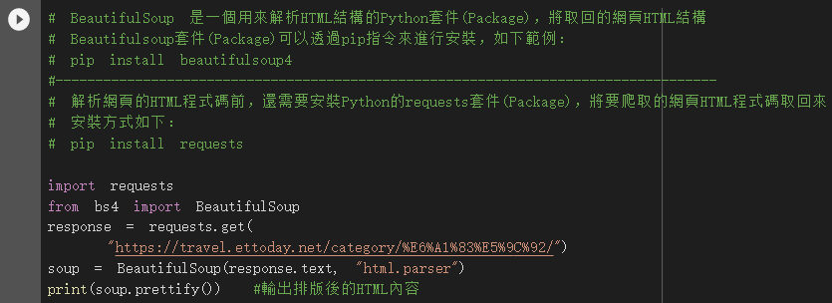
import requests
from bs4 import BeautifulSoup
response = requests.get(
"https://travel.ettoday.net/category/%E6%A1%83%E5%9C%92/")
soup = BeautifulSoup(response.text, "html.parser")
print(soup.prettify()) #輸出排版後的HTML內容

Slide 13
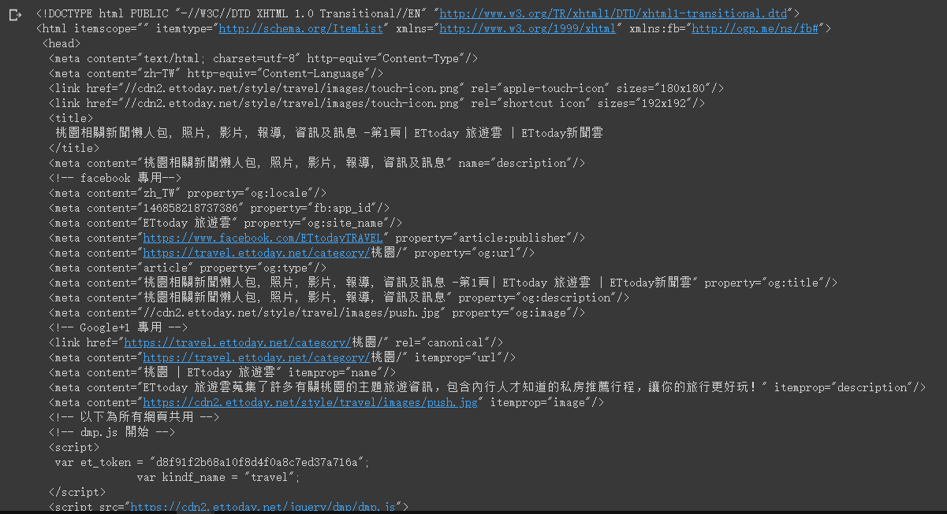
部分結果截圖

Slide 14
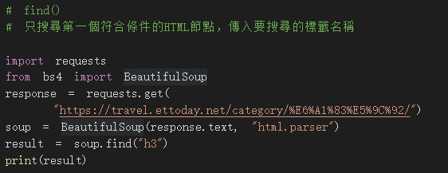
find()
# find()
# 只搜尋第一個符合條件的HTML節點，傳入要搜尋的標籤名稱
import requests
from bs4 import BeautifulSoup
response = requests.get(
“https://travel.ettoday.net/category/%E6%A1%83%E5%9C%92/”)
soup = BeautifulSoup(response.text, "html.parser")
result = soup.find("h3")
print(result)

Slide 15
結果截圖

Slide 16
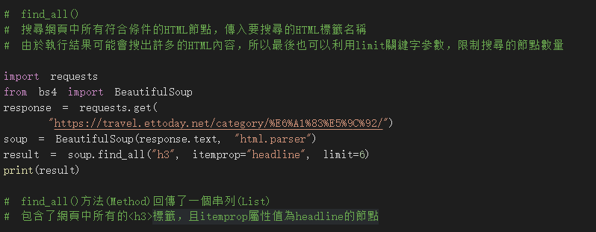
find_all()
import requests
from bs4 import BeautifulSoup
response = requests.get(
“https://travel.ettoday.net/category/%E6%A1%83%E5%9C%92/”)
soup = BeautifulSoup(response.text, "html.parser")
result = soup.find_all("h3", itemprop="headline", limit=6)
print(result)

Slide 17
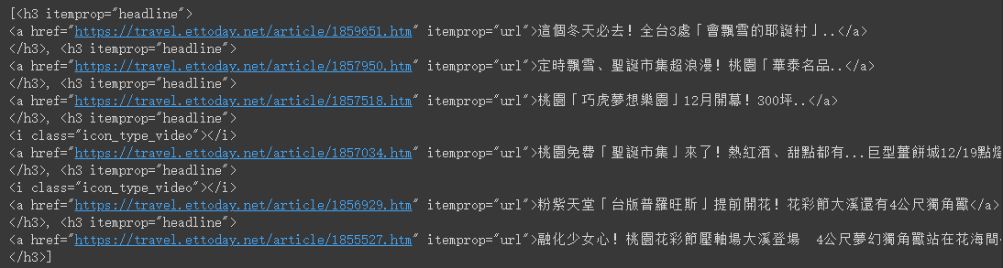
結果截圖
反之在 find_add() 後不加 limit 來限制的話則全部顯示出來

Slide 18
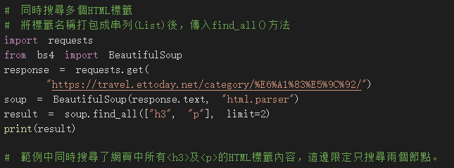
同時搜尋多個HTML標籤
import requests
from bs4 import BeautifulSoup
response = requests.get(
"https://travel.ettoday.net/category/%E6%A1%83%E5%9C%92/")
soup = BeautifulSoup(response.text, "html.parser")
result = soup.find_all(["h3", "p"], limit=2)
print(result)

Slide 19
結果截圖

Slide 20
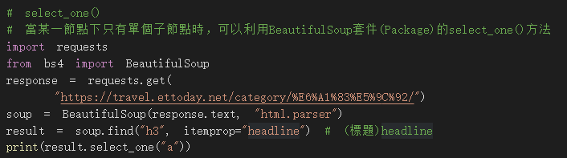
# select_one()
import requests
from bs4 import BeautifulSoup
response = requests.get(
"https://travel.ettoday.net/category/%E6%A1%83%E5%9C%92/")
soup = BeautifulSoup(response.text, "html.parser")
result = soup.find("h3", itemprop="headline") # (標題)headline
print(result.select_one("a"))

Slide 21
結果截圖
<a href="https://travel.ettoday.net/article/1859651.htm" itemprop="url">這個冬天必去！全台3處「會飄雪的耶誕村」..</a>
注意(ちゅうい)：
因為這裡使用 find 所以(だから)才顯示一個而已
要多個查詢要使用find_all

Slide 22
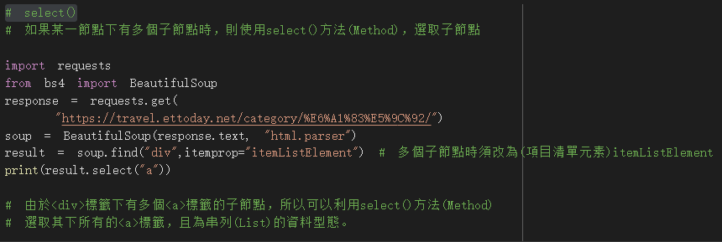
select()
import requests
from bs4 import BeautifulSoup
response = requests.get(
"https://travel.ettoday.net/category/%E6%A1%83%E5%9C%92/")
soup = BeautifulSoup(response.text, "html.parser")
result = soup.find("div",itemprop="itemListElement")
# 多個子節點時須改為(項目清單元素)itemListElement
print(result.select("a"))

Slide 23
結果截圖
[<a class="pic" href="https://travel.ettoday.net/article/1859651.htm">
<img data-original="https://cdn2.ettoday.net/images/5284/c5284491.jpg" itemprop="image" onerror="this.src='//cdn2.ettoday.net/style/travel/images/fb_ettoday_travel_logo.jpg'" src="https://cdn2.ettoday.net/style/misc/loading_200x150.gif"/>
</a>,
<a href="https://travel.ettoday.net/article/1859651.htm" itemprop="url">這個冬天必去！全台3處「會飄雪的耶誕村」..</a>]

Slide 24
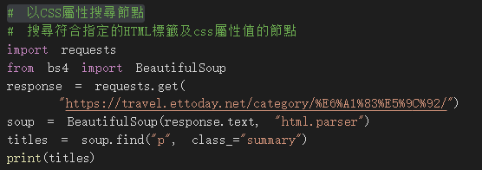
以CSS屬性搜尋節點
import requests
from bs4 import BeautifulSoup
response = requests.get(
"https://travel.ettoday.net/category/%E6%A1%83%E5%9C%92/")
soup = BeautifulSoup(response.text, "html.parser")
titles = soup.find("p", class_="summary")
print(titles)

Slide 25
結果截圖
<p class="summary" itemprop="description">聖誕節即將到來，全台各地今年聖誕活動也陸續開跑！全台就有3處會下雪的浪漫耶誕村，從即日起陸續登場，活動更一直持續到2021年，讓旅客可以享受濃濃耶誕氛圍，還能在冬日中享受走進浪漫燈海裡盡情拍照。</p>
注意(ちゅうい)：
因為這裡使用 find 所以(だから)才顯示一個而已
要多個查詢要使用find_all

Slide 26
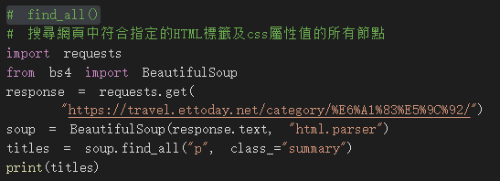
find_all()屬性搜尋節點
import requests
from bs4 import BeautifulSoup
response = requests.get(
"https://travel.ettoday.net/category/%E6%A1%83%E5%9C%92/")
soup = BeautifulSoup(response.text, "html.parser")
titles = soup.find_all("p", class_="summary")
print(titles)

Slide 27
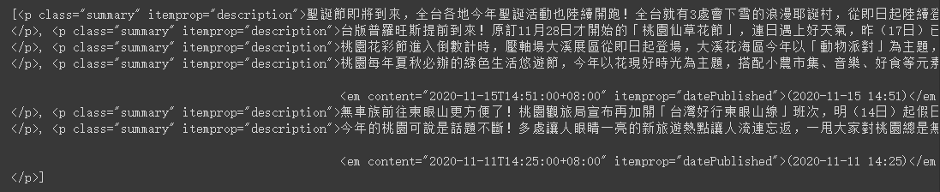
結果截圖

Slide 28
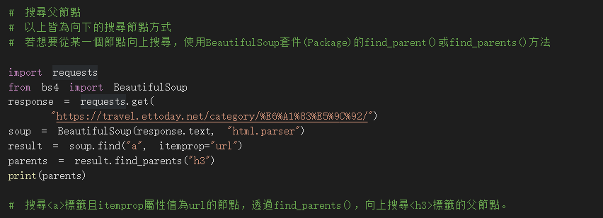
搜尋父節點(find_parents)
import requests
from bs4 import BeautifulSoup
response = requests.get(
"https://travel.ettoday.net/category/%E6%A1%83%E5%9C%92/")
soup = BeautifulSoup(response.text, "html.parser")
result = soup.find("a", itemprop="url")
parents = result.find_parents("h3")
print(parents)

Slide 29
結果截圖
[<h3 itemprop="headline">
<a href="https://travel.ettoday.net/article/1859651.htm" itemprop="url">這個冬天必去！全台3處「會飄雪的耶誕村」..</a>
</h3>]

Slide 30
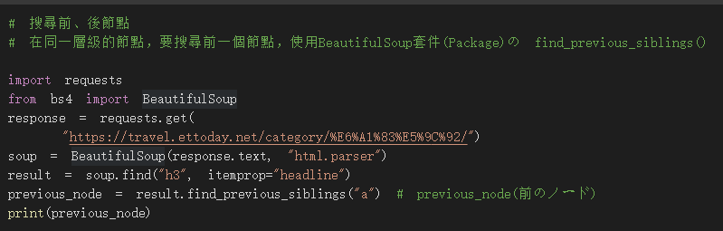
搜尋前、後節點(find_previous_siblings)
import requests
from bs4 import BeautifulSoup
response = requests.get(
"https://travel.ettoday.net/category/%E6%A1%83%E5%9C%92/")
soup = BeautifulSoup(response.text, "html.parser")
result = soup.find("h3", itemprop="headline")
previous_node = result.find_previous_siblings("a") # previous_node(前のノード)
print(previous_node)

Slide 31
結果截圖
[<a class="pic" href="https://travel.ettoday.net/article/1859651.htm">
<img data-original="https://cdn2.ettoday.net/images/5284/c5284491.jpg" itemprop="image" onerror="this.src='//cdn2.ettoday.net/style/travel/images/fb_ettoday_travel_logo.jpg'" src="https://cdn2.ettoday.net/style/misc/loading_200x150.gif"/>
</a>]

Slide 32
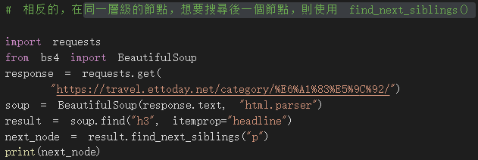
同一層級的節點，搜尋後一個節點， find_next_siblings()
import requests
from bs4 import BeautifulSoup
response = requests.get(
"https://travel.ettoday.net/category/%E6%A1%83%E5%9C%92/")
soup = BeautifulSoup(response.text, "html.parser")
result = soup.find("h3", itemprop="headline")
next_node = result.find_next_siblings("p")
print(next_node)

Slide 33
結果截圖
[<p class="summary" itemprop="description">聖誕節即將到來，全台各地今年聖誕活動也陸續開跑！全台就有3處會下雪的浪漫耶誕村，從即日起陸續登場，活動更一直持續到2021年，讓旅客可以享受濃濃耶誕氛圍，還能在冬日中享受走進浪漫燈海裡盡情拍照。</p>]

Slide 34
# 取得屬性值
# 在前範例中，皆為取得所需之HTML節點，而如果想要取得某一個節點中的屬性值，則可以利用BeautifulSoup套件(Package)的get()方法(Method)。
# 例えば：想要爬取「ETtoday的旅遊雲」桃園景點首頁的標題連結
# 利用find_all()方法搜尋網頁中所有<h3>標籤且itemprop屬性值為headline的節點
# 接著，透過for迴圈讀取串列(List)中的節點，由於<h3>標籤底下只有一個<a>標籤
import requests
from bs4 import BeautifulSoup
response = requests.get(
"https://travel.ettoday.net/category/%E6%A1%83%E5%9C%92/")
soup = BeautifulSoup(response.text, "html.parser")
titles = soup.find_all("h3", itemprop="headline")
for title in titles:
print(title.select_one("a"))

Slide 35
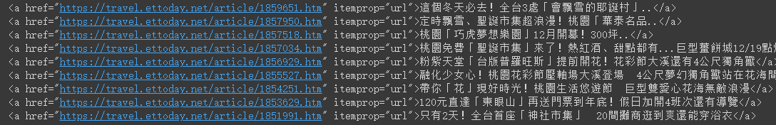
結果截圖
<a href="https://travel.ettoday.net/article/1859651.htm" itemprop="url">這個冬天必去！全台3處「會飄雪的耶誕村」..</a> <a href="https://travel.ettoday.net/article/1857950.htm" itemprop="url">定時飄雪、聖誕市集超浪漫！桃園「華泰名品..</a> <a href="https://travel.ettoday.net/article/1857518.htm" itemprop="url">桃園「巧虎夢想樂園」12月開幕！300坪..</a> <a href="https://travel.ettoday.net/article/1857034.htm" itemprop="url">桃園免費「聖誕市集」來了！熱紅酒、甜點都有...巨型薑餅城12/19點燈</a> <a href="https://travel.ettoday.net/article/1856929.htm" itemprop="url">粉紫天堂「台版普羅旺斯」提前開花！花彩節大溪還有4公尺獨角獸</a> <a href="https://travel.ettoday.net/article/1855527.htm" itemprop="url">融化少女心！桃園花彩節壓軸場大溪登場 4公尺夢幻獨角獸站在花海間</a> <a href="https://travel.ettoday.net/article/1854251.htm" itemprop="url">帶你「花」現好時光！桃園生活悠遊節 巨型雙愛心花海無敵浪漫</a> <a href="https://travel.ettoday.net/article/1853629.htm" itemprop="url">120元直達「東眼山」再送門票到年底！假日加開4班次還有導覽</a> <a href="https://travel.ettoday.net/article/1851991.htm" itemprop="url">只有2天！全台首座「神社市集」 20間攤商逛到爽還能穿浴衣</a>

Slide 36
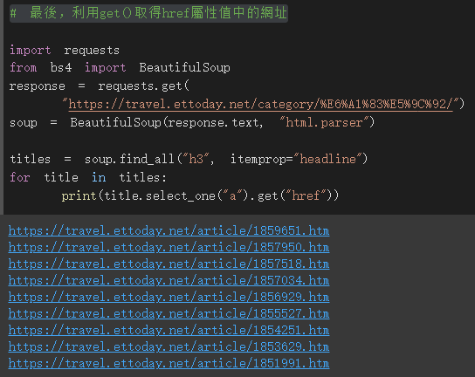
利用get()取得href屬性值中的網址
執行結果

Slide 37
# 最後，利用get()取得href屬性值中的網址
import requests
from bs4 import BeautifulSoup
response = requests.get(
"https://travel.ettoday.net/category/%E6%A1%83%E5%9C%92/")
soup = BeautifulSoup(response.text, "html.parser")
titles = soup.find_all("h3", itemprop="headline")
for title in titles:
print(title.select_one("a").get("href"))

Slide 38
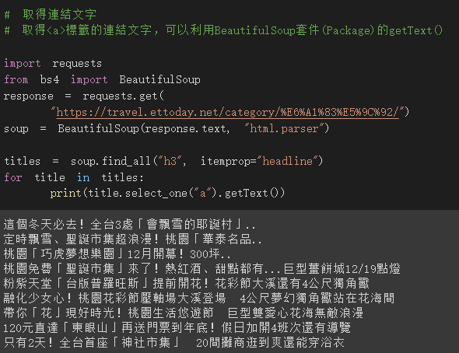
取得連結文字

Slide 39
# 取得連結文字
# 取得<a>標籤的連結文字，可以利用BeautifulSoup套件(Package)的getText()
import requests
from bs4 import BeautifulSoup
response = requests.get(
"https://travel.ettoday.net/category/%E6%A1%83%E5%9C%92/")
soup = BeautifulSoup(response.text, "html.parser")
titles = soup.find_all("h3", itemprop="headline")
for title in titles:
print(title.select_one("a").getText())

